Slide 1
CPR E 281: Digital Logic
Md Maruf Ahamed
Office: 307 Durham Center
Phone: (515) 294-6323
Email: maruf@iastate.edu

Slide 2
Administrative Stuff
  Homework: HW #04 due on Sunday @ 11:59 PM
  Quiz: Quiz #4 due on Friday @ 4:25 PM
  Recitation: Recitation #04 this week
  Lab: Lab # 05 this week
      Submit pre-lab prior to the lab otherwise you will lose 20% points
  Lecture-14 Readings: Section 3.3

Slide 3
13–Addition of Unsigned Numbers
  Unsigned vs Signed numbers
  Half-Adder
  Full-Adder
  n-bit ripple-carry adder
  Design examples

Slide 4

Addition of Unsigned Numbers
3.1, 3.2

Slide 5

Number Systems
base
power
n-th digit
(most significant)
0-th digit
(least significant)

Slide 6

Base 7
Base 2

Slide 7
Another Way to Look at This
labels
Base 7
Base 10
Base 2
7²
7¹
7⁰
10²
10¹
10⁰
2²
2¹
2⁰
5
2
4
2
6
3
1
0
0
boxes

Slide 8
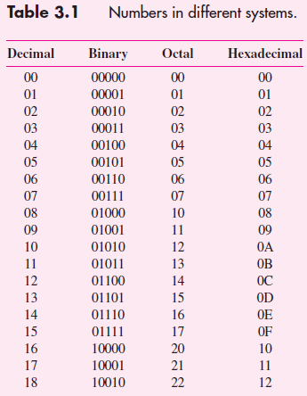

Slide 9
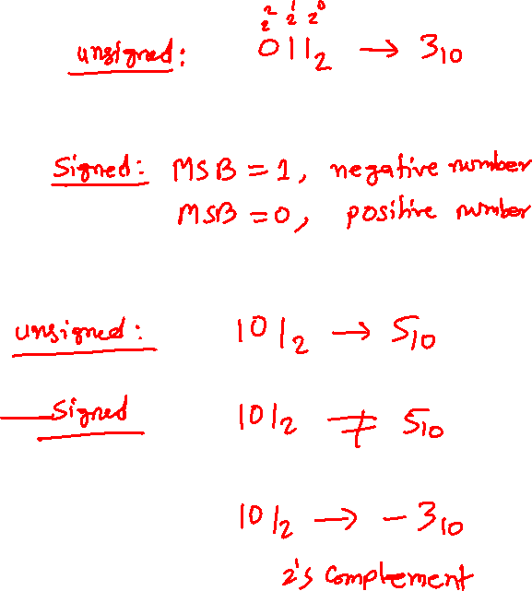
Binary numbers
Unsigned numbers
all bits represent the magnitude of a positive integer
Signed numbers
left-most bit represents the sign of a number

Slide 10
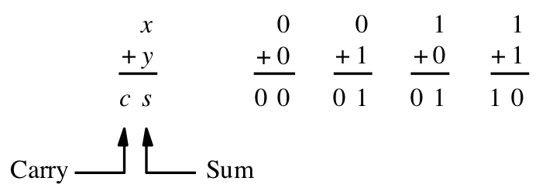
Adding two bits
There are four possible cases:
[ Figure 3.1a from the textbook ]

Slide 11
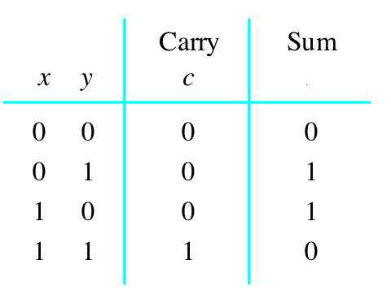

Adding two bits
There are four possible cases:
Truth table
s

Slide 12
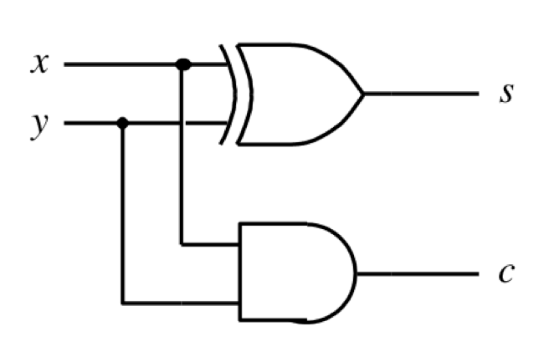
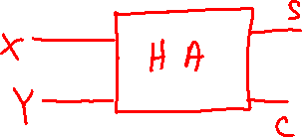
Adding two bits
There are four possible cases:
Truth table
Logic circuit
s

Slide 13
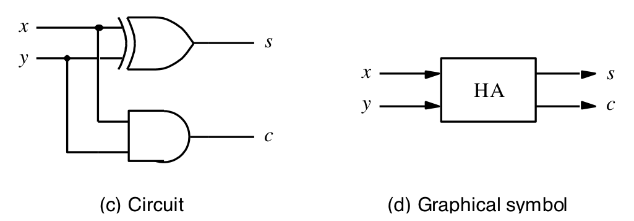
The Half-Adder
This circuit, which implements the addition of only two bits, is called a half-adder.
[ Figure 3.1c-d from the textbook ]

Slide 14
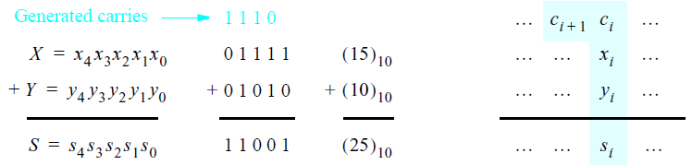
Addition of multibit numbers
Bit position i
[ Figure 3.2 from the textbook ]

Slide 15
Analogy with addition in base 10
c₃ c₂ c₁ c₀
x₂ x₁ x₀
y₂ y₁ y₀
s₂ s₁ s₀
+

Slide 16
Analogy with addition in base 10
3 8 9
1 5 7
5 4 6
+

Slide 17

Analogy with addition in base 10
0 1 1 0
3 8 9
1 5 7
5 4 6
carry
+

Slide 18
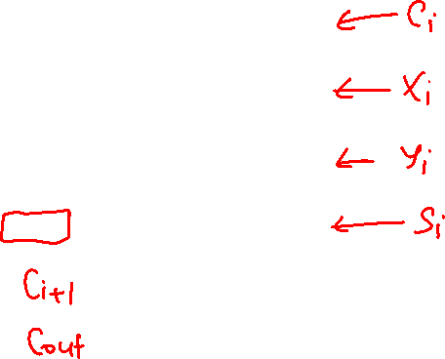
Analogy with addition in base 10
c₃ c₂ c₁ c₀
x₂ x₁ x₀
y₂ y₁ y₀
s₂ s₁ s₀
+

Slide 19
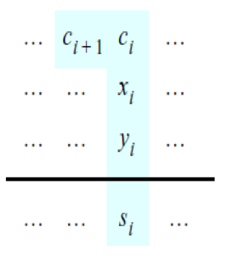
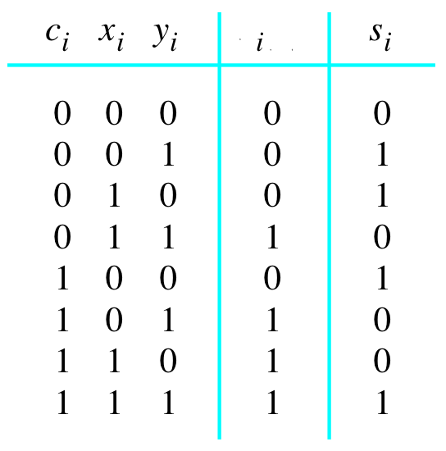

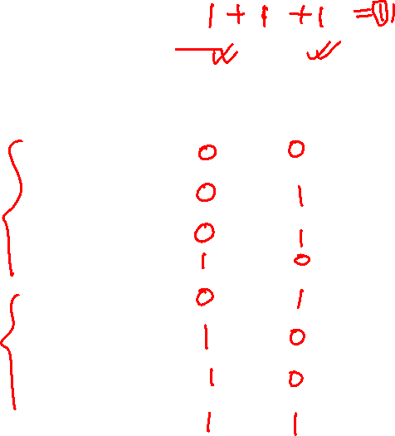
Problem Statement and Truth Table
[ Figure 3.2b from the textbook ]
[ Figure 3.3a from the textbook ]

Slide 20
Problem Statement and Truth Table
[ Figure 3.2b from the textbook ]
[ Figure 3.3a from the textbook ]

Slide 21
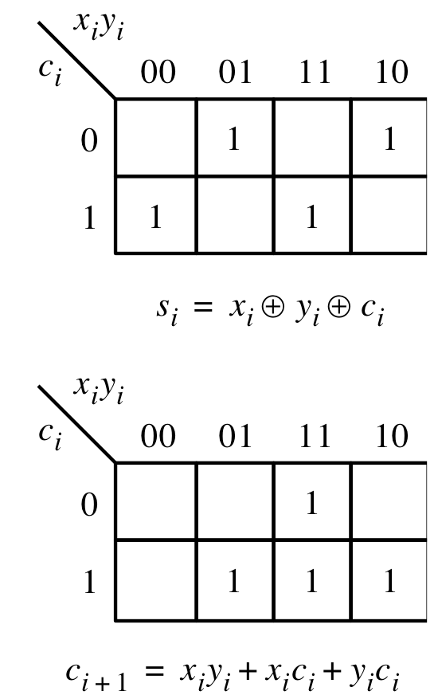
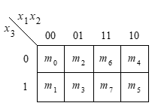
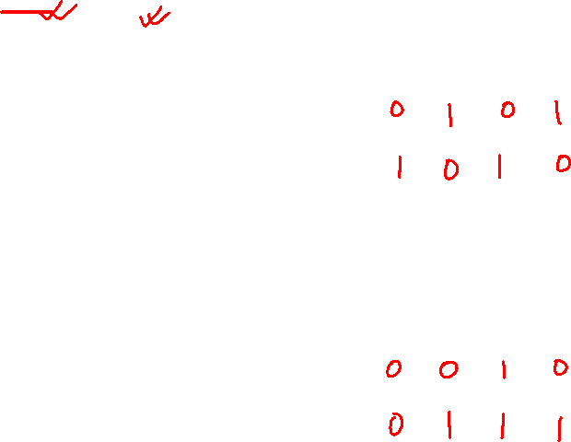
Let’s fill-in the two K-maps
[ Figure 3.3a-b from the textbook ]

Slide 22

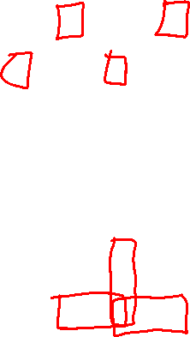
Let’s fill-in the two K-maps
[ Figure 3.3a-b from the textbook ]

Slide 23
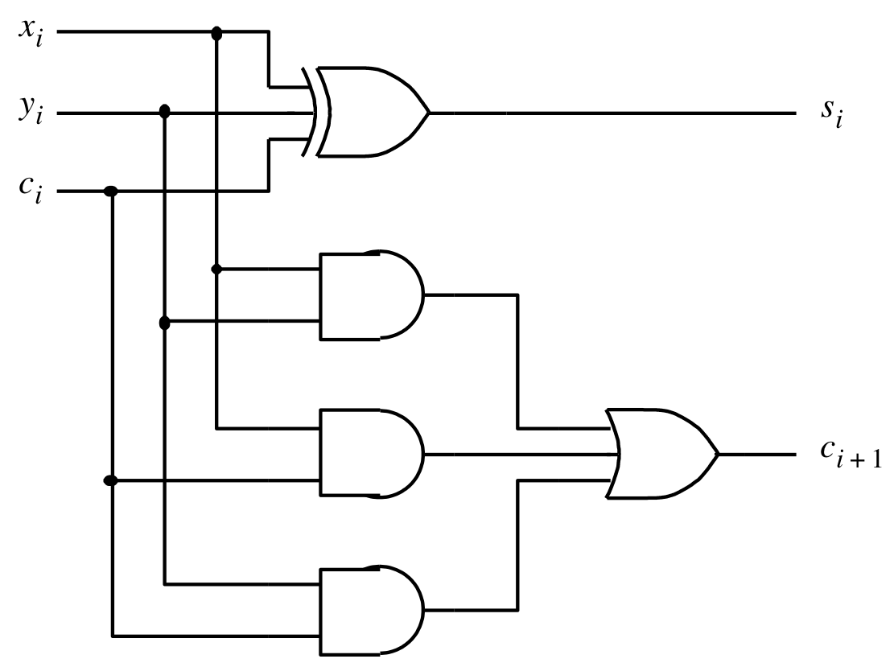


The circuit for the two expressions
[ Figure 3.3c from the textbook ]

Slide 24
This is called the Full-Adder
[ Figure 3.3c from the textbook ]

Slide 25
XOR Magic

Slide 26
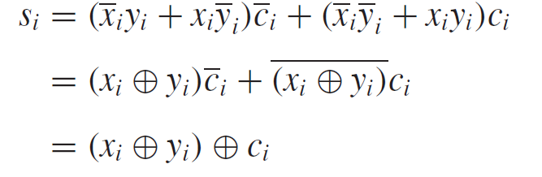
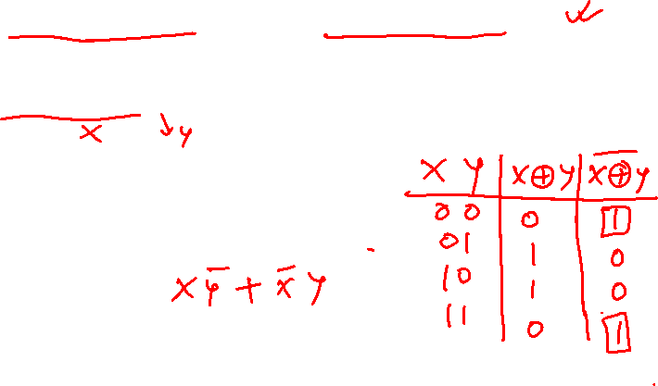
XOR Magic

Slide 27
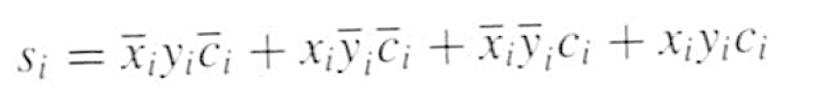
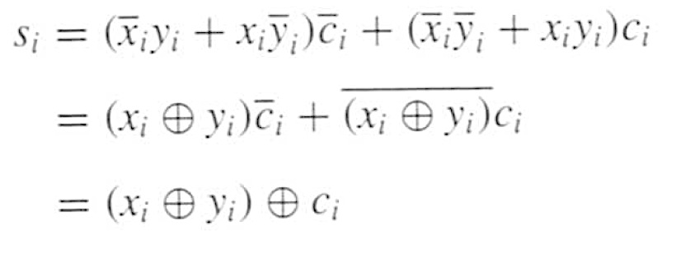
XOR Magic
Can you prove this?

Slide 28


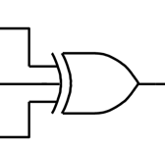

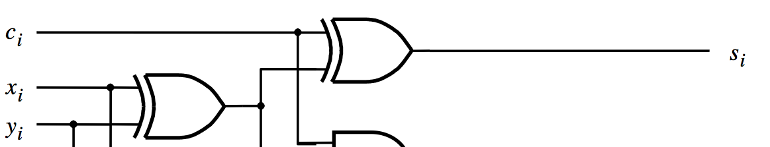
XOR Magic
(s_{i} can be implemented in two different ways)

Slide 29
A decomposed implementation
of the full-adder circuit

Slide 30
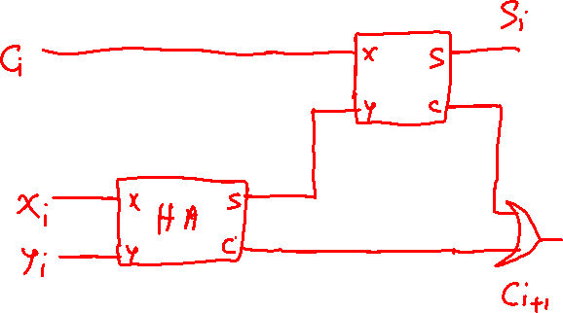
A decomposed implementation
of the full-adder circuit

Slide 31
A decomposed implementation
of the full-adder circuit
c
s
s
i
s
HA
c
i
x
i
HA
c
c
y
i
+
1
i
(a) Block diagram
[ Figure 3.4 from the textbook ]

Slide 32
A decomposed implementation
of the full-adder circuit
c
s
s
i
s
HA
c
i
x
i
HA
c
c
y
i
+
1
i
(a) Block diagram
c
i
s
i
x
i
y
i
c
i
+
1
(b) Detailed diagram
[ Figure 3.4 from the textbook ]

Slide 33
The Full-Adder Abstraction
c
s
s
i
HA
i
x
s
c
i
HA
c
y
c
i
+
1
i

Slide 34
The Full-Adder Abstraction
c
s
i
i
x
FA
i
c
y
i
+
1
i

Slide 35
We can place the arrows anywhere
x_{i}
y_{i}
c_{i+1}
FA
c_{i}
s_{i}

Slide 36
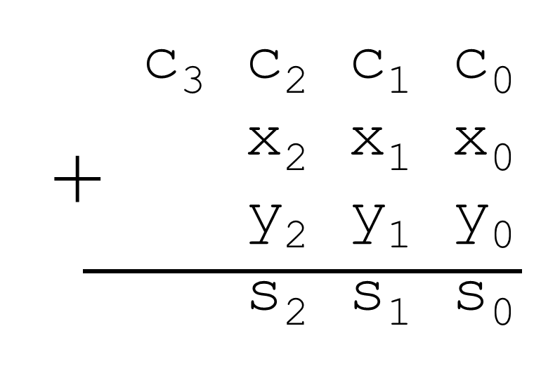

n-bit ripple-carry adder
x
y
x
y
x
y
n –
1
n
1
1
0
0
–
1
c
c
c
c
1
c
n
FA
n
”
1
2
FA
FA
0
s
s
s
n
–
1
1
0
MSB position
LSB position
Because of the way the carry signals “ripple” through the full-adder
stages, the circuit in Figure 3.5 is called a ripple-carry adder.
[ Figure 3.5 from the textbook ]

Slide 37
n-bit ripple-carry adder abstraction
x
y
x
y
x
y
n –
1
n
1
1
0
0
–
1
c
c
c
c
1
c
n
FA
n
”
1
2
FA
FA
0
s
s
s
n
–
1
1
0
MSB position
LSB position

Slide 38
n-bit ripple-carry adder abstraction
x
y
x
y
x
y
n –
1
n
1
1
0
0
–
1
c
c
n
0
s
s
s
n
–
1
1
0

Slide 39
The x and y lines are typically
grouped together for better visualization,
but the underlying logic remains the same
x
x
x
y
y
y
n –
1
1
0
n
1
0
–
1
c
c
n
0
s
s
s
n
–
1
1
0

Slide 40
Design Example:
Create a circuit that multiplies an eight-bit unsigned number by 3

Slide 41
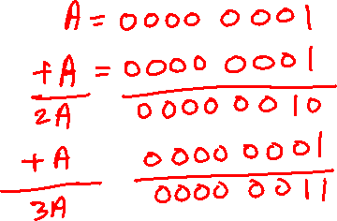
How to Get 3A from A?
Let A denote the eight bit number.
3A = A + A + A
3A = (A+A) + A
3A = 2A +A

Slide 42
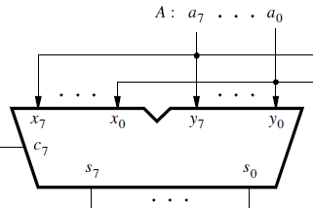
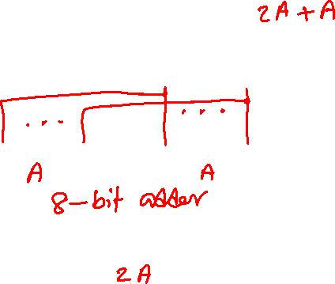
How to Get 3A from A?
Let A denote the eight bit number.
3A = A + A + A
3A = (A+A) + A
3A = 2A +A

Slide 43
How to Get 3A from A?
Let A denote the eight bit number.
3A = A + A + A
3A = (A+A) + A
3A = 2A +A

Slide 44
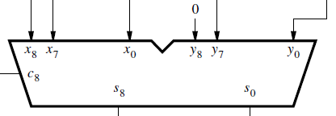
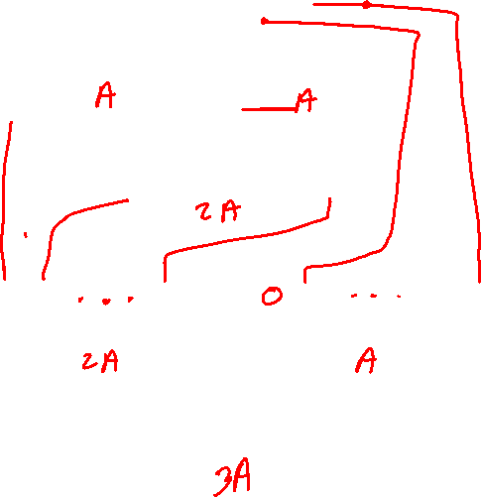
How to Get 3A from A?
Let A denote the eight bit number.
3A = A + A + A
3A = (A+A) + A
3A = 2A +A

Slide 45
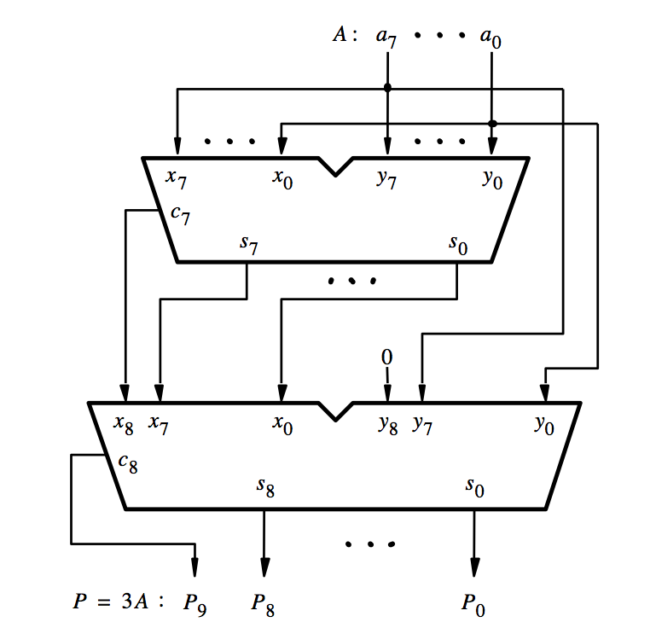
How to Get 3A from A?
[ Figure 3.6a from the textbook ]

Slide 46
How to Get 3A from A?
A
A
[ Figure 3.6a from the textbook ]

Slide 47
How to Get 3A from A?
A
A
2A
[ Figure 3.6a from the textbook ]

Slide 48

How to Get 3A from A?
A
A
2A
A
[ Figure 3.6a from the textbook ]

Slide 49
How to Get 3A from A?
A
A
2A
A
3A
[ Figure 3.6a from the textbook ]

Slide 50
Decimal Multiplication by 10
What happens when we multiply a number by 10?
  4 x 10 = ?
542 x 10 = ?
1245 x 10 = ?

Slide 51
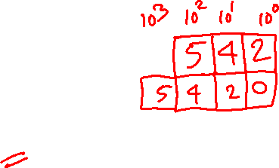
Decimal Multiplication by 10
What happens when we multiply a number by 10?
  4 x 10 = 40
542 x 10 = 5420
1245 x 10 = 12450
You simply add a zero as the rightmost number

Slide 52
Binary Multiplication by 2
What happens when we multiply a number by 2?
  011 times 2 = ?
101 times 2 = ?
110011 times 2 = ?

Slide 53
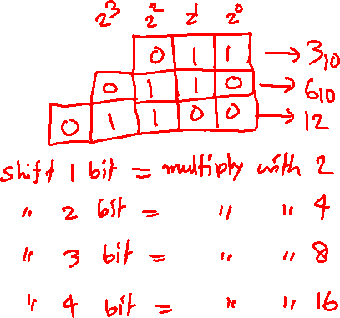
Binary Multiplication by 2
What happens when we multiply a number by 2?
  011 times 2 = 0110
101 times 2 = 1010
110011 times 2 = 1100110
You simply add a zero as the rightmost number

Slide 54
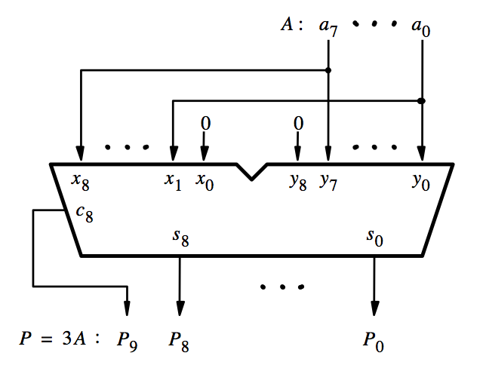
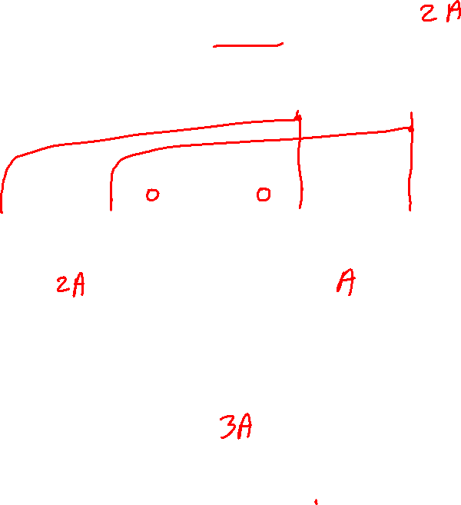
Efficient way to Get 3A from?
[ Figure 3.6b from the textbook ]

Slide 55
Efficient way to Get 3A from?
[ Figure 3.6b from the textbook ]

Slide 56


Efficient way to Get 3A from?
This is how we get 2A
[ Figure 3.6b from the textbook ]

Slide 57
Efficient way to Get 3A from?
2A
A
3A
[ Figure 3.6b from the textbook ]

Slide 58
Example 1: Let A be a four-bit unsigned number. Use a seven-bit adder (and NOT gates, as necessary) to design a circuit that calculates the following operations: X = 4A + 2A

Slide 59
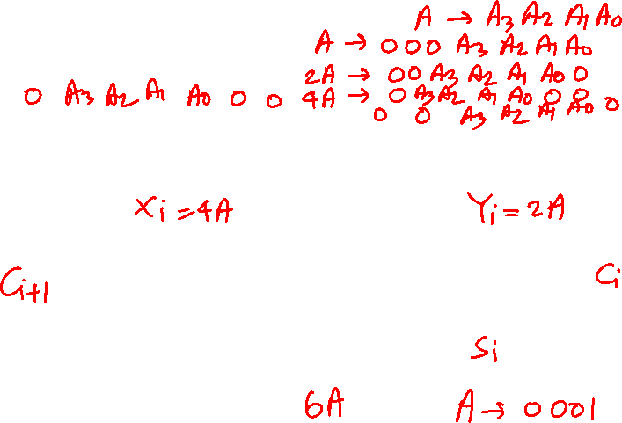
Example 1: Let A be a four-bit unsigned number. Use a seven-bit adder (and NOT gates, as necessary) to design a circuit that calculates the following operations: X = 4A + 2A

Slide 60
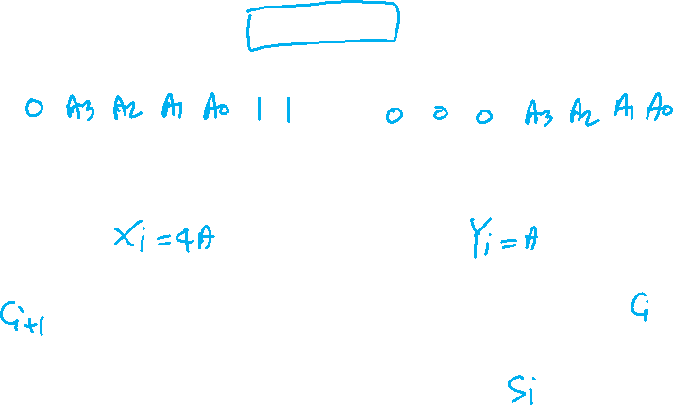
Example 2: Let A be a four-bit unsigned number. Use a seven-bit adder (and NOT gates, as necessary) to design a circuit that calculates the following operations: X = 5A + 3

Slide 61
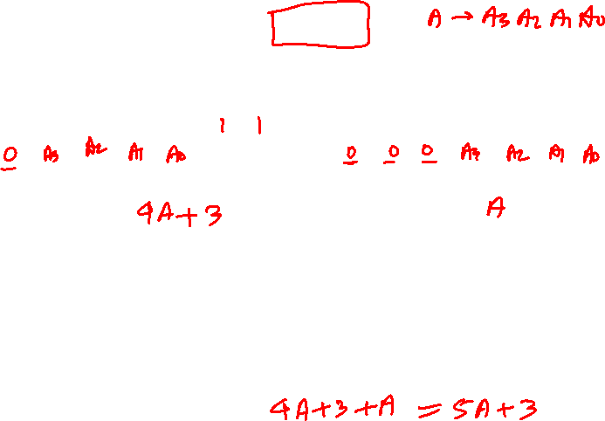
Example 2: Let A be a four-bit unsigned number. Use a seven-bit adder (and NOT gates, as necessary) to design a circuit that calculates the following operations: X = 5A + 3

Slide 62
Midterm 1: Open discussion

Slide 63

END Slide

